Slide 1
Cyclistic bike-share case study
Google data analytics capstone project
April,2024
By: Alhassan Mohammed

Slide 2
How members and casual riders use cyclistic bikes differently
Annual Members:
Frequency of Use: Annual members consistently have a higher total count of rides throughout the year. They rely on Cyclistic bikes as part of their regular routine, possibly for daily commuting, errands, or consistent travel needs.

Slide 3
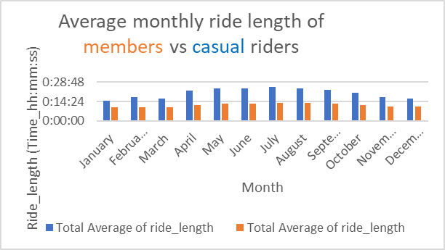
How members and casual riders use cyclistic bikes differently
Annual Members:
2. Shorter Rides: Members tend to take shorter rides, with an average ride length of around 10 to 13 minutes. These rides may be purpose-driven, such as commuting to work or running errands.

Slide 4
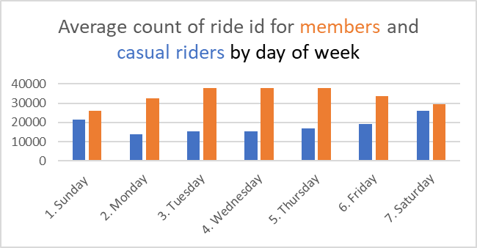
How members and casual riders use cyclistic bikes differently
Annual Members:
3. Weekday Focus: Members predominantly use the bike-sharing service on weekdays, suggesting that they rely on it for their daily work or school commute.

Slide 5
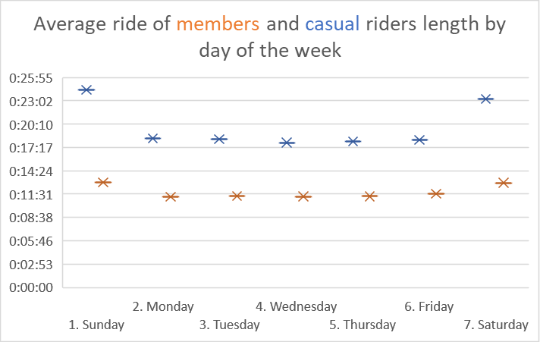
How members and casual riders use cyclistic bikes differently
2. Casual Riders:
Leisurely Exploration: Casual riders exhibit longer average ride lengths, often around 20 to 25 minutes. They use Cyclistic bikes for leisurely exploration, sightseeing, or recreational purposes.
Weekend Adventures: Casual riders are more active on weekends, taking advantage of the flexibility offered by single-ride or full-day passes. They enjoy longer rides during pleasant weather conditions.

Slide 6
recommendations
Offer special discounts or incentives to encourage casual riders to become annual members. Highlight the cost savings and benefits of membership, such as unlimited rides throughout the year.
Consider promotions like reduced annual membership fees for the first year or additional perks (e.g., priority access to bikes, free helmet rentals) to attract casual riders.
Tailor marketing campaigns specifically for casual riders. Highlight the convenience and flexibility of single-ride or full-day passes.

